Slide 1

Neural Nets Deep Dive
Data Science Immersive

Slide 2
Agenda today
Review intuition of neural nets
Introduction to neural nets cost function
Use computation graph to visualize backward propagation
Activation functions & when to use them

Slide 3
Students will be able to
Understand the role gradient descent and backprop play in a simple neural net (multilayer perceptron)
Understand and explain how backpropagation works to optimize for parameters
Understand and explain the role of different activation in neural nets

Slide 4
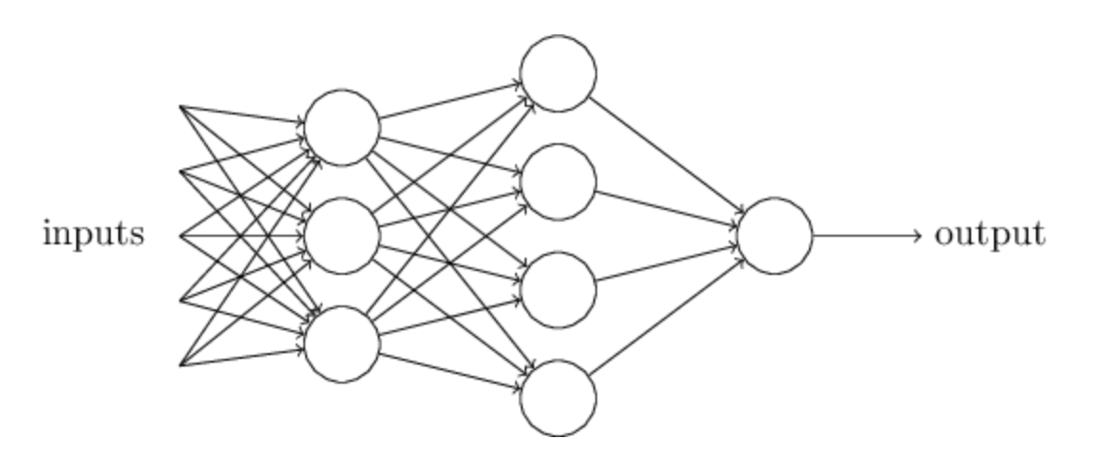
Review for Neural Nets

Slide 5
Need for optimization
Recall from last class - each neuron gets assigned a weight at the connection before passing through the hidden layer
The weight associated with the neurons determine the final outcome
Therefore, it is important to train your model to learn the optimal weights in order to minimize the cost function of your neural nets

Slide 6
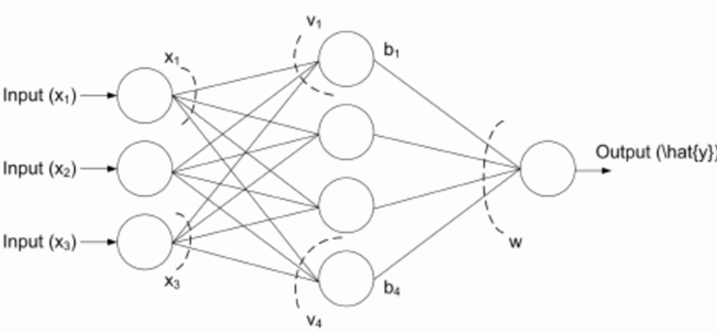
Need for optimization
Multilayer Perceptron is just a neural network in which there is one hidden layer between the input and output layer, and one nonlinear activation function
So let’s start today’s lesson with a network with one hidden layer and a sigmoid function as the output

Slide 7
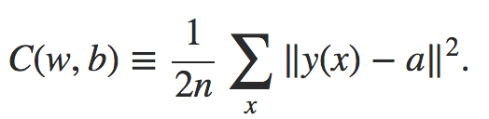
Cost Function
The cost function of a neural net can be represented as the total sum of square error between the predicted values and actual values across all training example
In an example of neural net with final activation function of output layer of Sigmoid Function, the cost function can be represented as:
Notes:
Here, w denotes the collection of all weights in the network, b all the biases, n is the total number of training inputs, aa is the vector of outputs from the network when x is input, and the sum is over all training inputs, x.

Slide 8
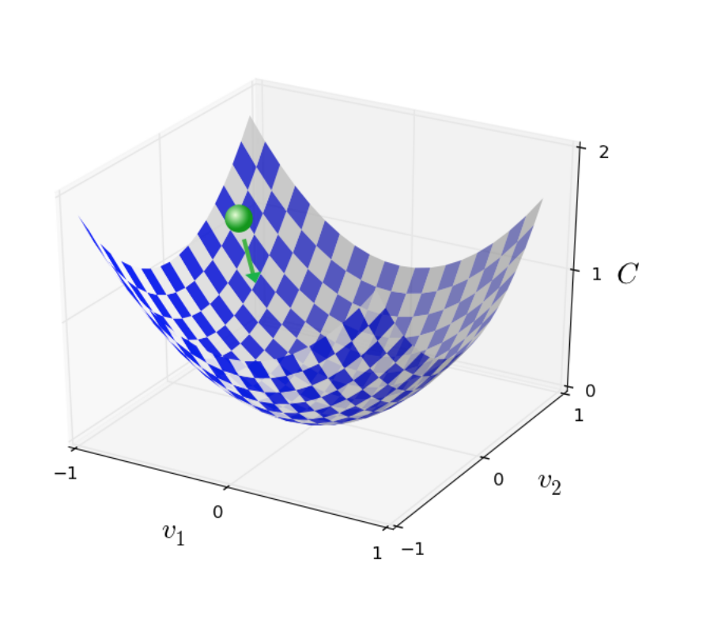
Cost Function
So the aim of our training algorithm will be to minimize the cost C(w,b) as a function of the weights and biases
In other words, we want to find a set of weights and biases which make the cost as small as possible. We'll do that using gradient descent

Slide 9
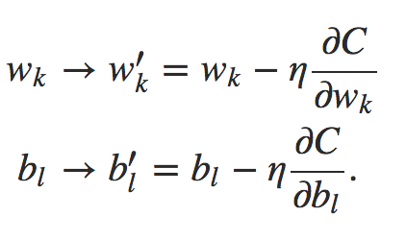
Gradient Descent
We can represent in a neural net’s simplest format, we want to find the optimal value of weight (w) and bias that minimizes the above cost function
The updated gradient of w and b can be represented as:

Slide 10
Gradient Descent
Implementing gradient descent on all training examples can be extremely cumbersome, therefore we use a technique called mini-batch
We will talk about different types of gradient descent later and how they make our algorithms run faster
Stochastic gradient descent
Mini-batch

Slide 11
How to calculate the weights?
By now, we have talked about using gradient descent to find the optimal weights and biases
But we have yet to show how to use gradient descent on the cost function
In order to use gradient on the cost function to find w and b, we need to understand a powerful algorithm backpropagation, which powers neural nets

Slide 12
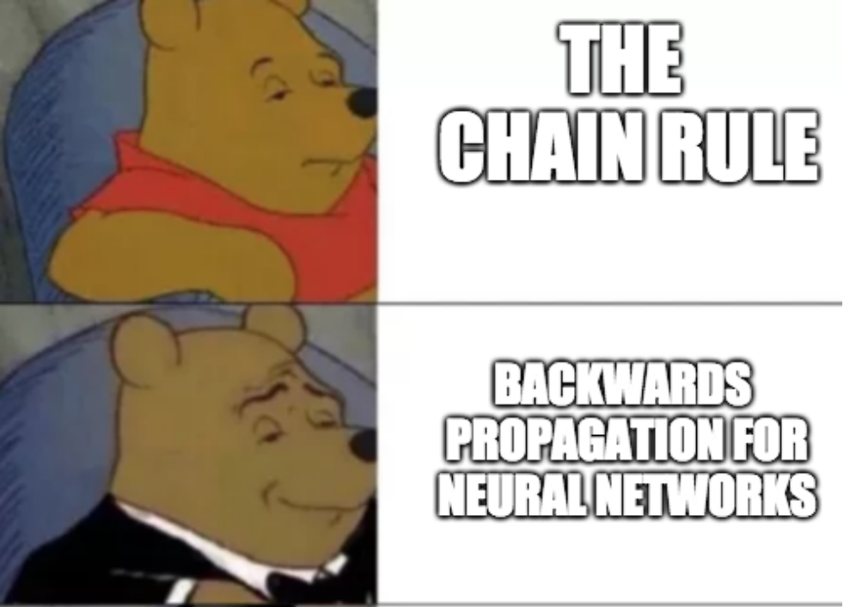
Backpropagation

Slide 13
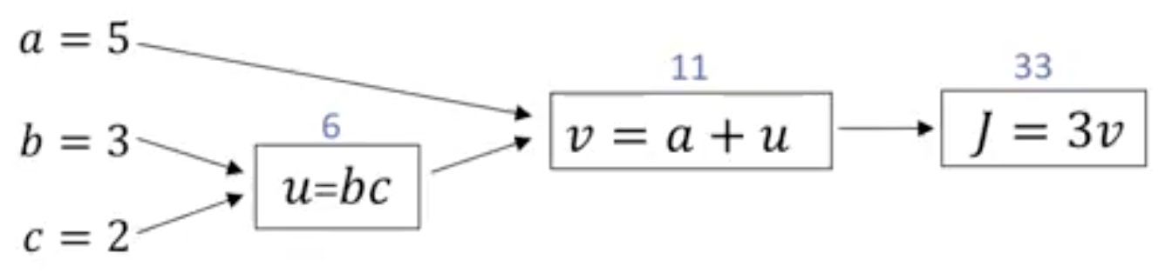
Computation graph
Let’s use a small example to demonstrate
What is 3(a + bc) if a = 5, b = 3, and c = 2
This is actually a three step processes which can be broken down into:
U = bc
V = a + u
J = 3v

Slide 14
Derivative of Computation Graph
Given the previous computation graph, what is the value of dj/dv?
Notes:
The value of dj/dv is how much j would change with respect to v? It is 3

Slide 15
Derivative of Computation Graph
To compute the gradient of j with respect to v, we only need to take one step backwards.
What about dj/da?
Notes:
How much change in a would affect the change in j?

Slide 16
Derivative of Computation Graph
Taking the derivative of j in respect to a would also give you 3 because:
A = 5 → 5.001
V = 11 → 11.001
J = 33 → 33.003

Slide 17
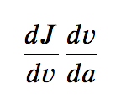
Derivative of Computation Graph
Therefore, we can see that taking the derivative of j in respect to a is equivalent to

Slide 18
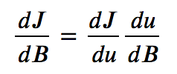
Derivative of Computation Graph
What about ?

Slide 19
Backpropagation
Using the idea in computation graph, we can propagate the error term backwards in the system to adjust the values of w and b
the backward movement is a consequence of the fact that the cost is a function of outputs from the network
To understand how the cost varies with earlier weights and biases we need to repeatedly apply the chain rule, working backward through the layers to obtain usable expressions

Slide 20
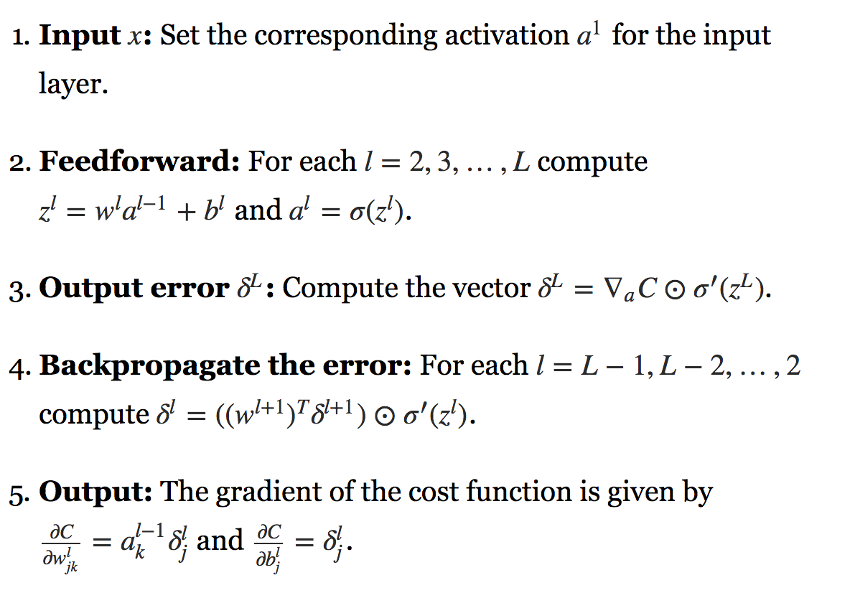
Algorithm of Backpropagation

Slide 21
Activation Functions
It is not essential to understand how to hand implement derivative of certain activation functions, we just need to know what some of the common ones are
Sigmoid
Tanh (the hyperbolic tangent)
ReLu
Leaky ReLu

Slide 22
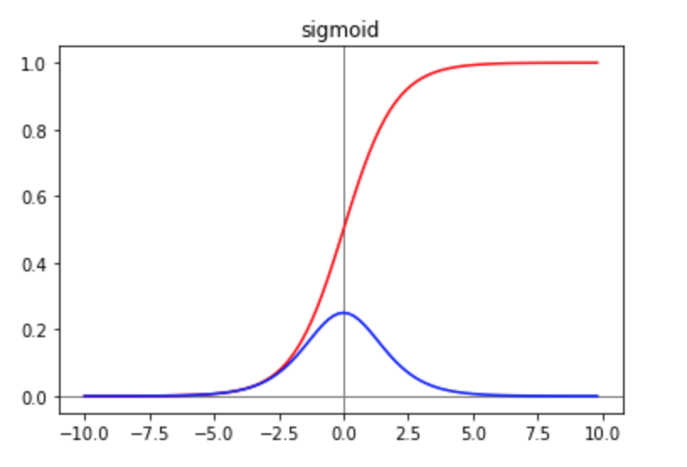
Activation Function
The Sigmoid
Not very commonly used in the hidden layer because taking the gradient can be slow
It is, however, a natural choice for output layer when the outcome is binary

Slide 23
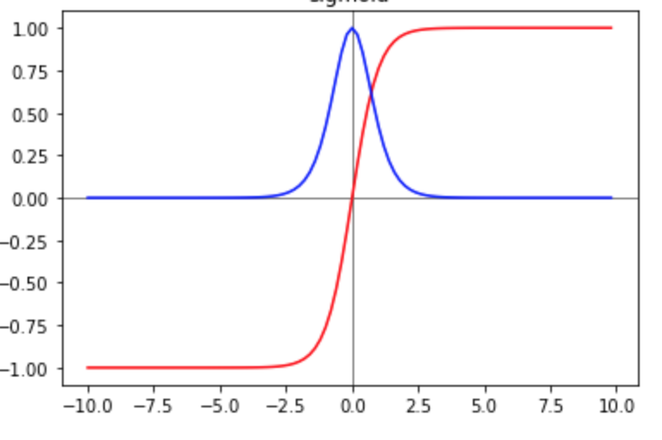
Activation Function
The hyperbolic tangent

Slide 24
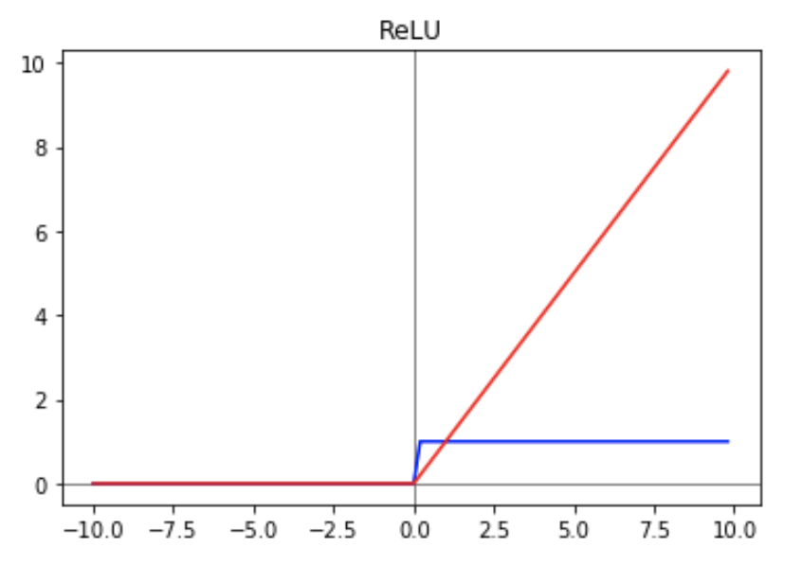
Activation Function
The Rectified Linear Unit Function (ReLu)
Notes:
The problem of using relu is that neurons with negative values will just have 0 gradient, which means they are dead and hard to recover from its death.
https://medium.com/tinymind/a-practical-guide-to-relu-b83ca804f1f7

Slide 25
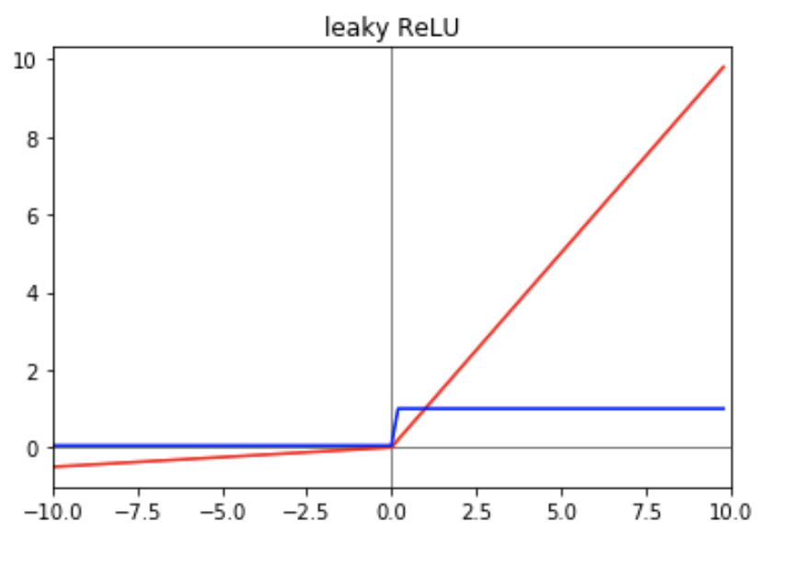
Activation Function
Leaky ReLu

Slide 26
To be continued...
Implementation details in python and keras
Different types of gradient descent: batch vs mini-batch vs stochastic
Random initialization

Slide 27
Citations
Deep Learning and Neural Networks textbook
Deep Learning and Neural Networks by Andrew Ng
Notes:
http://neuralnetworksanddeeplearning.com/chap1.html textbook

